Slide 1
Docker 101
https://github.com/kaenovsky/sturdy-docker | Docker course by Ahmed Alkabary

Slide 2

https://docker.com

Slide 3
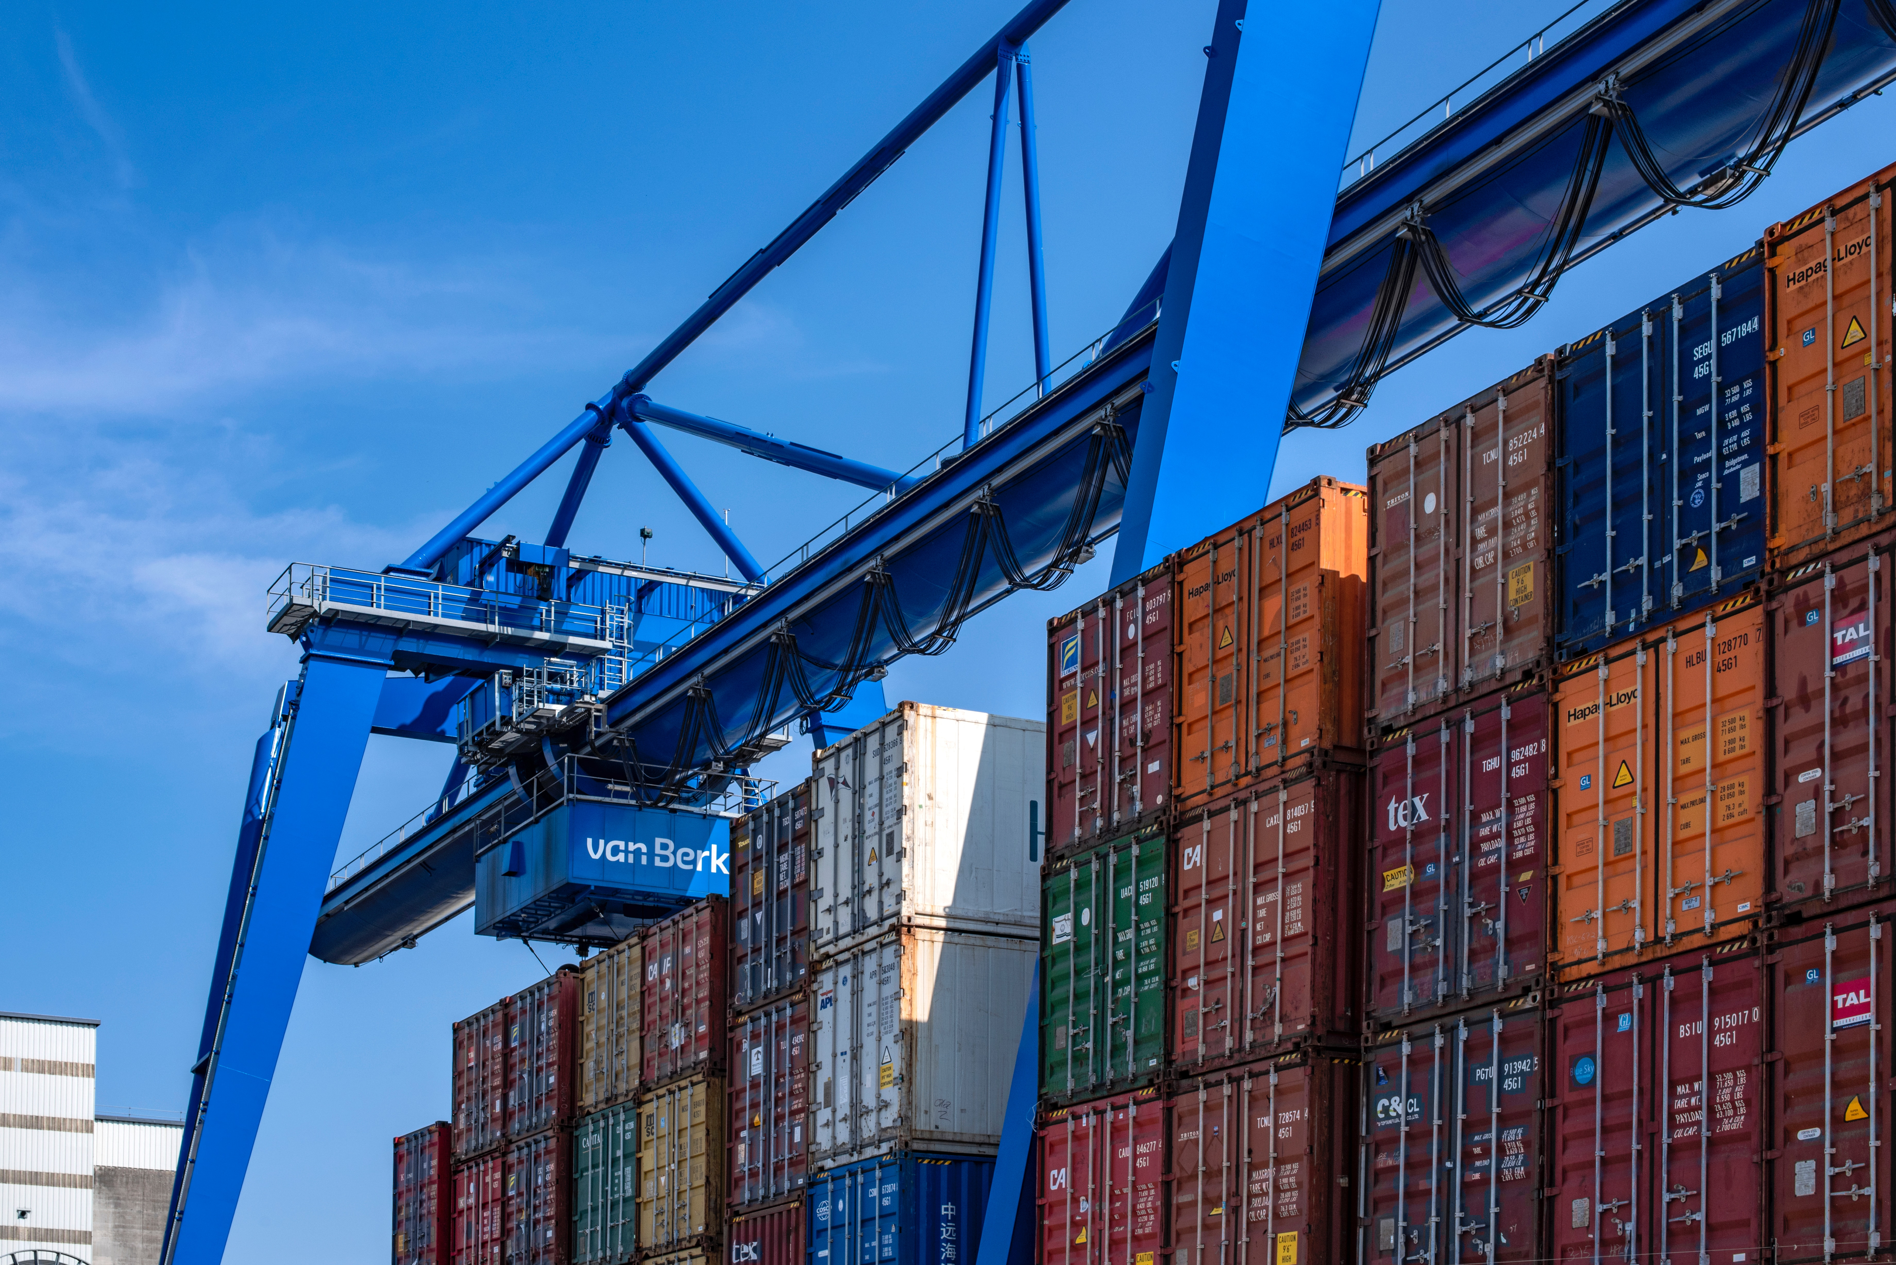
Photo by Lucas van Oort | Unsplash

Slide 4




Slide 5
Instalación
https://docs.docker.com/engine/install/debian/#install-using-the-repository

Slide 6
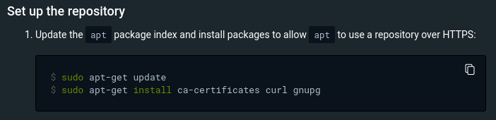
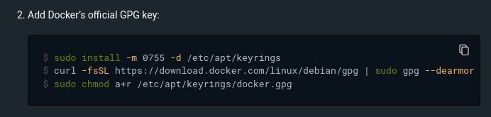
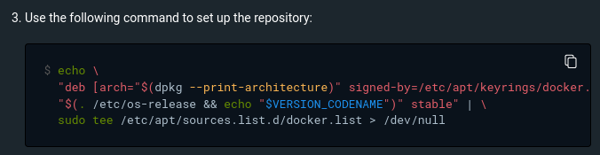
https://docs.docker.com/engine/install/debian/#install-using-the-repository

Slide 7
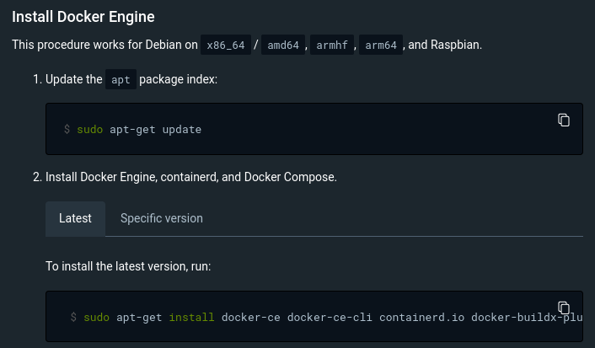
https://docs.docker.com/engine/install/debian/#install-using-the-repository

Slide 8
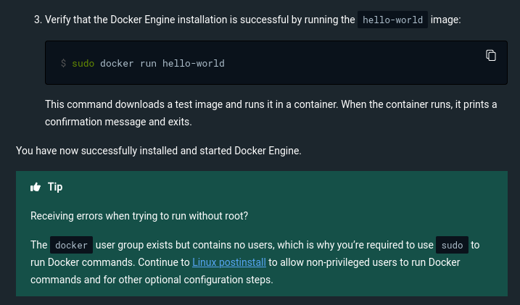
https://docs.docker.com/engine/install/debian/#install-using-the-repository

Slide 9
Otros OS
https://docs.docker.com/desktop

Slide 10
Container
Imagen
https://github.com/kaenovsky/sturdy-docker/blob/main/image-v-container.md

Slide 11
Puertos:
Container
Host
https://github.com/kaenovsky/sturdy-docker/blob/main/container-port-v-host-port.md

Slide 12
Data persistente en Volúmenes
https://docs.docker.com/storage/volumes/

Slide 13
Demo localhost
Demo VPS

Slide 14
Fin : )

